Slide 1
Validation of Satellite Image with Ground Sensor Network based on
OGC Web Services Framework
Sarawut NINSAWAT
Ryousuke Nakamura, Hirokazu Yamamoto, Akihide Kamei and Satoshi Tsuchida
GEO Grid Research Group/ITRI/AIST
Notes:
Urbanization and Geo-environmental monitoring
Web-GIS for Geo-environmental monitoring
Geospatial interoperability
FOSS for Geoinformatics

Slide 2
Introduction
The utilization of satellite remote sensing image
  Widely applied and been recognized as powerful and effective tool
  Monitoring state of the environments
Benefit of satellite RS:
  Cheap and rapid over large geographic area
  Regional coverage and broadly spectral resolution
  Continuous acquisition of data
  Archive of historical data
Limitation of satellite RS:
  Not direct sample of the phenomenon.
  Interference of atmospheric gaseous and particles
    Absorbing (H₂0, O₃ etc.) and Scattering ( mainly by aerosol particles such as dust, ash and smoke)

Slide 3
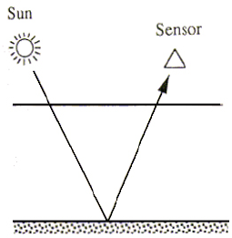
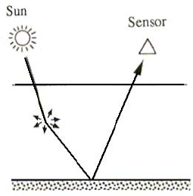
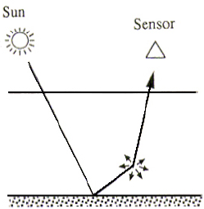
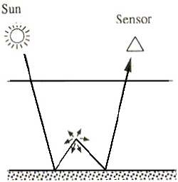
Surface reflectance and
Top of the atmosphere
Image from: http://www.profc.udec.cl/~gabriel/tutoriales/rsnote/cp9/cp9-2.htm
Notes:
A portion of the light that reaches a sensor flying overhead actually comes from the Earth's atmosphere, not the surface of the Earth.
This signal from the atmosphere, which can obscure the signal emanating from the land or water of interest, is caused by molecular scattering and absorbing of gas and particles in the atmosphere.
Particles such as dust, ash, and smoke also scatter light reflected from the Earth's surface.

Slide 4
Cal/Val for satellite products
Surface reflectance is basic product for higher level products (land use, land cover, biomass, etc …)
  Need to convert the “top of the atmosphere” signal to the “surface reflectance”.
  Estimating the surface spectral reflectance as it would have been measured at ground level
  Use Radiative Transfer Model (6S, MODTRAN, etc …)
  Need atmospheric parameters (satellite-based and/or ground-based)
  Especially, aerosol over land is complicated by the higher variability and spatial heterogeneity
  Need to calibrate/validate for surface reflectance and atmospheric parameters
Focused on aerosol parameters in this research

Slide 5
MODIS (MODerate-resolution Imaging Spectroradiometer)
Capable of viewing the entire globe daily at moderate resolutions
  Ranging from 250 meters to 1 kilometer pixels.
  36 spectral bands ranging in wavelength from 0.4 µm to 14.4 µm
  Land, Cloud, Aerosol properties, Atmosphere, Ocean color etc.
  Various products generated for earth observation purpose
    Vegetation indices, leaf area index, sea surface temperature.
  6S is a basic code for MODIS atmospheric correction algorithm.
  Gaseous condition - > MOD05 and MOD07
  Cloud mask -> MOD35
  Aerosol concentration -> MOD04

Slide 6
MOD04 and MOD08
The algorithm retrieves daily Aerosol Optical Depth (AOD) as known as MOD04 in Level two product
  Using seven bands of MODIS.
  Resolution at 1 x 1, 5 x 5 and 10 x 10 km.
The MOD08 is a Level three product as global dataset from MOD04, MOD05, MOD06, and MOD07
  Daily Global, Eight-day Global and Monthly Global ( Resolution 1º x 1º )
Validation with ground observation is necessary to improve uncertainly estimate.
Band | Wavelength (µm) | Resolution (m) | Primary Use
1 | 0.620-0.670 | 250 | Land/Cloud/Aerosols Boundaries
2 | 0.841-0.876 | 250
3 | 0.459-0.479 | 500 | Land/Cloud/Aerosols Properties
4 | 0.545-0.565 | 500
5 | 1.230-1.250 | 500
6 | 1.628-1.652 | 500
7 | 2.105-2.155 | 500

Slide 7
PEN
Phenological Eyes Network
  Monitoring dynamics of the ecosystem
  Validate satellite information with reliable information on ground level
Measurement equipments:
  Sunphoto meter (SP)
    11 spectral bands with FOV 1 degree at 10 minutes interval
    Optical thickness, aerosol size and aerosol refractive index etc.
    Main purpose for atmospheric correction and aerosol monitoring
  Automatic-capturing Digital Fisheye Camera (ADFC)
    High quality images of the sky, canopy, branch and ground
    2 – 180 minutes interval
    Sky condition at satellite overpass time.
  Hemi-Spherical Spectral Radiometer (HSSR)

Slide 8
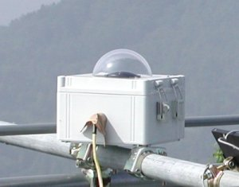
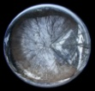
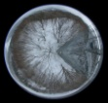
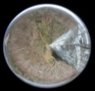
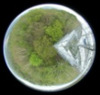


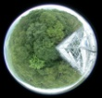
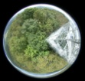
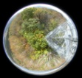
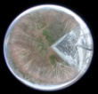
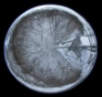
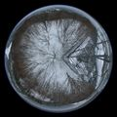
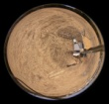
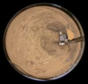
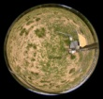
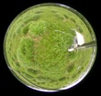
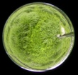
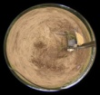
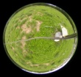
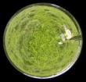
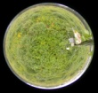
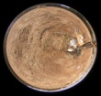
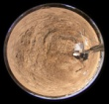
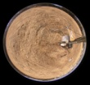
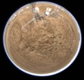
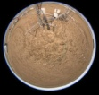
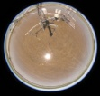
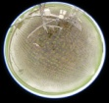
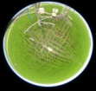
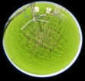
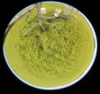
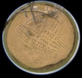
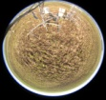
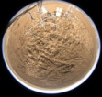
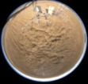
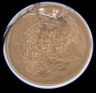
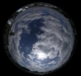
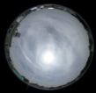
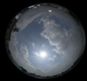
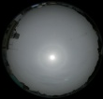
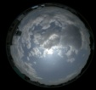
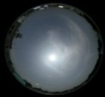
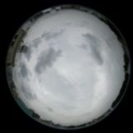
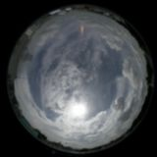
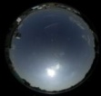
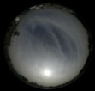
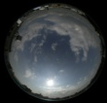
















PEN Equipments
Mar.
Apr.
May
Jun.
Jul.
Aug.
Sep.
Oct.
Nov.
Dec.
Jan.
Feb.
ADFC
TKY
TGF
MSE
RHN
SP
HSSR
http://www.pheno-eye.org

Slide 9
Validation (SP & MOD08)

Slide 10
Validation (SP & MOD08)

Slide 11
Validation (SP & MOD04)

Slide 12
Comparison (MOD08 & MOD04)

Slide 13




Previous System Framework
PSS
PMS
Input
Web
Page
Query DB
PEN Observation System
SP
PEN DB & Backup
ADFC
HSSR
Manipulating
(filter, average etc.)
Site B
Site C
Site D
Data Gathering
Query value at pixel
Validation and Plotting
Time consuming and need high level user experience.
Lack of Robustness and scalable
Not convenience for sharing among communities
MODIS MOD08
Daily image
Correction
On developing

Slide 14

Geo Grid
GEO (Global Earth Observation) GRID
  An E-Infrastructure to accelerate GEO science based on the concept that whole data related to earth observation are virtually integrated with a certain access management and easy to handle by the end-users those are enabled by a set of Grid and Web Service technologies.
Geo* Content
Grid and IT
Technologies
Applications
Satellite Data
Geology
GIS data
Environments
Resources
Field Data
Disaster
Management
Notes:
Satellite
ASTER
MODIS
PALSAR
GIS
Geological maps
Roads,railways, etc
Field
PEN

Slide 15

ASTER DEM on demand mosaic system
ASTER and PRISM DEM 3D Generation
Simulation of Pyrosclstic flows on volcano

Slide 16
OGC System Framework
PSS
SOS
WMS,WMS-T
PEN Observation System
52NorthSOS
Mapserver
SP
ADFC
HSSR
Overpass time
scene
MODIS MOD08
Daily image
GetObservation
[During MODIS overpass time from
start to end]
JSON
GetFeatureInfo
[MODIS value
from start to end]
JSON
GetObservation
ADFC
WPS
Execute
[station,start,end,product]
PyWPS
Validation process
Least Square Fitting process
JSON
R
rpy2
simplejson
Etc..
Client

Slide 17
WMS Time Tiling
WMS-T support for time request
  Time instance (etc. 2002-01-01)
  Time period (etc 2002-01-01/2002-10-11)
Currently, Mapserver do not support for WMS Time Tiling for “GetFeatureInfo” request with raster layer
  “errors that look like this msShapefileOpen(): Unable to access file. (f:/msapps/gmap-ms40/htdocs/my_layer_idx ” Ticket #2796
  Solution : WxS mapscript
gid | filename | the_geom | otime
1 | tiff/470/MOD08_D3_A2002010.tif | 01030… | 2002-01-10
2 | tiff/470/MOD08_D3_A2002011.tif | 01030… | 2002-01-11
3 | tiff/470/MOD08_D3_A2002012.tif | 01030… | 2002-01-12
.. | …………………………………….. | ……………. | …………….
WMS-T
Mapserver
Overpass time
scene
MODIS MOD08
Daily image
Mapfile
Location/Time Tiling DB
MOD08_D3_A2002010.tif
MOD08_D3_A2002011.tif

Slide 18

Prototype Application

Slide 19

Prototype Application

Slide 20

Chart Zooming

Slide 21
Conclusion
Comprehensive web-based GIS system framework enabled
  Based on various open standards of OGC specifications
  Using FOSS
    Mapserver, 52North SOS, PyWPS
    OpenLayers, jQuery,
Assimilation of sensor observation data and satellite image
  Wider area, More accuracy, Reasonable cost
Validation of aerosol properties from Satellite estimation with ground based sites
  Improve the following product which relied on satellite image “surface reflectance”

Slide 22
Future Development
Increase atmospheric observation network
  SKYNET, AERONET
Improving performance
  Distributing ground site data source
    More than two million records for two station and four years
  WMS-T full supported with Mapserver
  MOD03 overpass time to MOD08 Global dataset
    Possible to error 5 minutes observation request
Satellite image product validation
  GLEON (Global Lake Ecological Observatory Network)
    Lake monitoring : SST, Chl. A : MODIS Ocean product
  CO2 Flux monitoring : Asiaflux / Japanflux
Water Column Correction
  CREON (Coral Reef Environmental Observatory Network)
Validation with higher satellite image resolution
  ASTER, FORMOSAT-2

Slide 23









