Slide 1
OGC with FOSS4G 2009 and Beyond
Raj R. Singh
Director, Interoperability Programs
Open Geospatial Consortium (OGC)
October 21, 2009

Slide 3
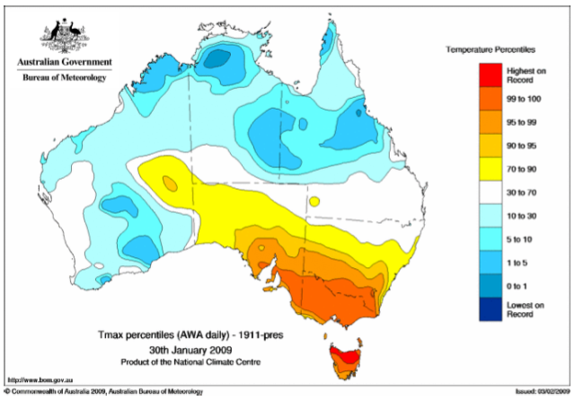
Nearly half of Tasmania had its hottest day on record
on 30 January 2009, with many records broken
by large margins, particularly in the north

Slide 4
CCIP Video

Slide 5
Climate Challenge Integration Plugfest 2009
CCIP experimented with ways to share the world’s meteorological and weather forecast data through open standards for geospatial information sharing

Slide 6
OGC, OSGEO, and FOSS4G in 2009
Web Map Tiling Service (WMTS)
Opensearch Geo
Reference Implementations
deegree
GeoNetwork Opensource
Geoserver
http://cite.opengeospatial.org/reference

Slide 7
OGC, OSGEO, and FOSS4G in 2010?
Keeping Reference Implementations in sync with Standards
TEAM Engine
Certification for FOSS
Who can certify?
What’s the cost?
Certification for integrators?
CCIP 2010!
Participate in OGC!

