Slide 1
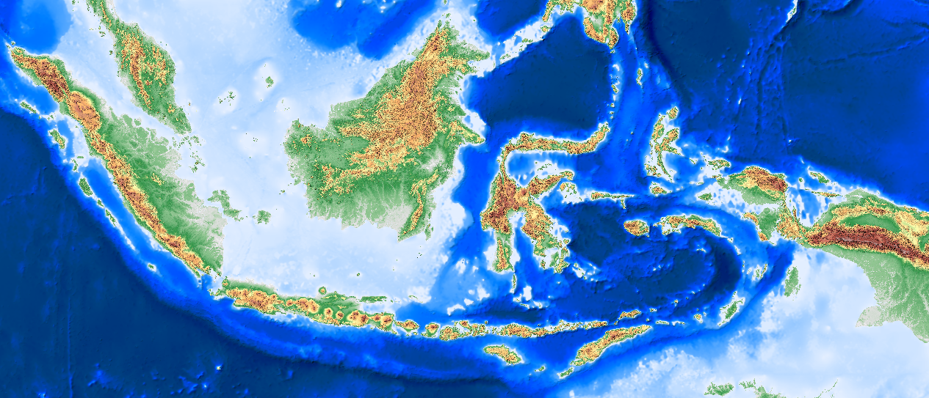

THE USE OF FREE AND OPEN SOURCES SOFTWARE FOR SPATIAL DATA CATALOG IN INDONESIA
Dewayany Sutrisno, Pramono G.H, Atie Rahadiati and Suseno.
pssdal@bakosurtanal.go.id
National Coordinating Agency for Surveys & Mapping
FOSS4G | Sydney | October, 20 – 23 , 2009

Slide 2
Outline
Background
National database
  Application
  Interoperability
Implementation
Conclusion
Further works
FOSS4G | Sydney | October, 20 – 23 , 2009

Slide 3
Background
The need for Spatial Database for national Management and goverment administration
Notes:
3

Slide 4

Background
Abundance of spatial data
Multi layers, Multi themes, Multi temporal
Need to be effectively managed
Storing, Searching , Retrieval, Sharing
The Program of
National Spatial Data Infrastructure
Huge area of coverage
Development of
WEB BASE CATALOG
FOSS4G | Sydney | October, 20 – 23 , 2009

Slide 5
Background
Multi scales
Multi Themes
Multi date
Data suistainability
Data infrastucture is needed
FOSS4G | Sydney | October, 20 – 23 , 2009

Slide 6



Background
Data catalog
Printout
Compact Disc (CD)
Internet
FOSS4G | Sydney | October, 20 – 23 , 2009

Slide 7
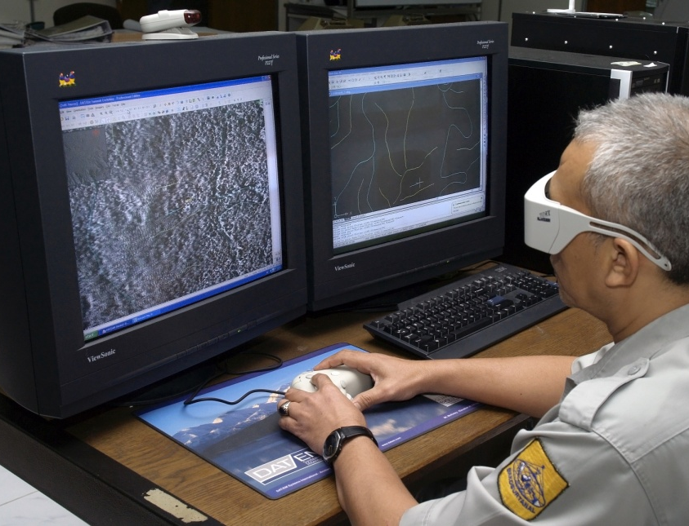
Background
Advantages of web based catalog:
24 hour service
Faster data updating
Accessible from anywhere
Minimum cost for data access
Direct access to the data
FOSS4G | Sydney | October, 20 – 23 , 2009

Slide 8
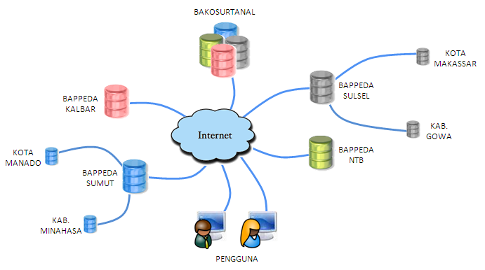
National Database
Distributed database
FOSS4G | Sydney | October, 20 – 23 , 2009

Slide 9
National Database
Advantages | Disadvantages
Reflecting organizational structure Regional offices are able to manage data Avoiding data interuption, due to hazard, electricity and administrative reasons Faster access Modular | Complicated system Regular data synchronization is needed Skillful staffs should be maintained Data security
FOSS4G | Sydney | October, 20 – 23 , 2009

Slide 10
Development
An application is developed as an interface between database and users
software:
  Webserver: Apache 2.0.55 open source in GPL (General Public lisence), http: //www.apache.org
  Scripting & editting: PHP ver 4.3.4, http://www.php/org
    Chamelon: script for webGIS development
    AuraCMS:script for website template
  Database: MySQL ver 14.1.14-nt, http://www.mysgl.org
  Mapserver ver 4.8, OGC, http://mapserver.gis.umn.edu
  Data spatial format: Shape file
FOSS4G | Sydney | October, 20 – 23 , 2009

Slide 11
Development
Searching Method: map sheet, administrative area and theme.
Main nformation:
Institutional description
Metadata: FGDC standard
Spatial data of selected area : shape file
Advantages:
This inexpensive configuration helps reducing the total budget to develop the system
Can be installed on every data center within all of the provinces and regencies
FOSS4G | Sydney | October, 20 – 23 , 2009

Slide 12
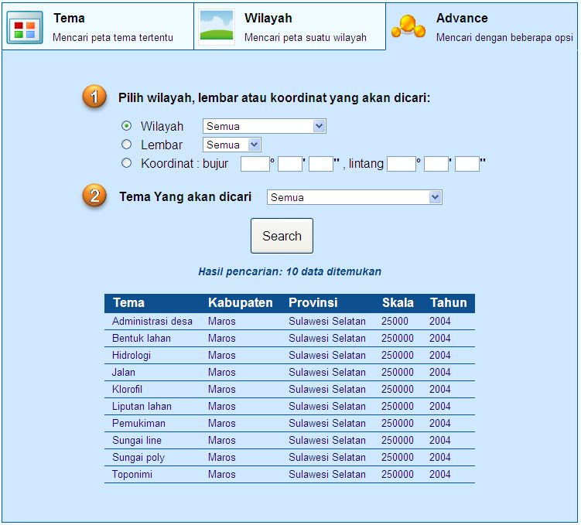
APPLICATION
Data searching

Slide 13
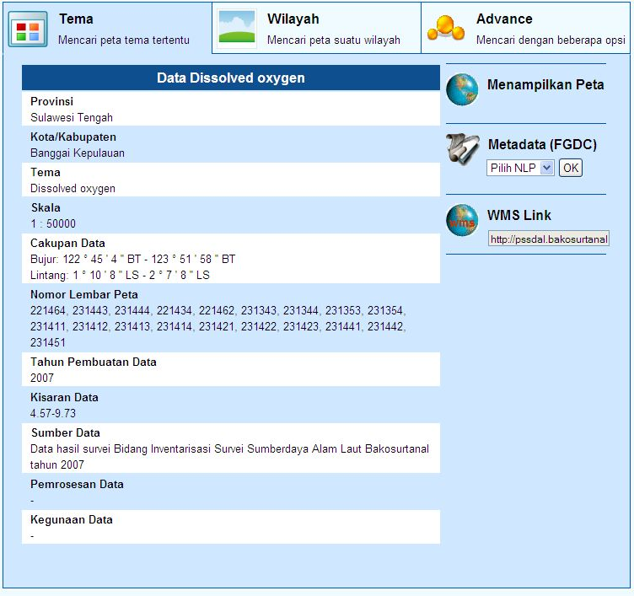
APPLICATION
Metadata display

Slide 14
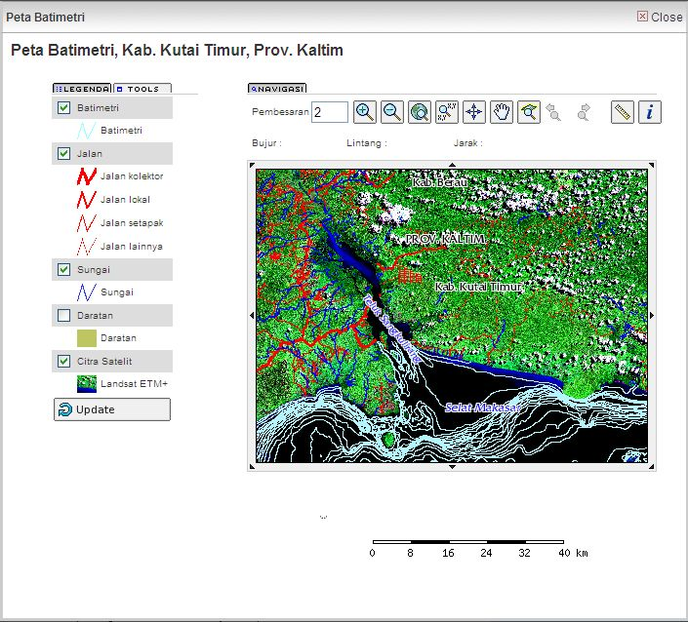
APPLICATION
Data display [web GIS]

Slide 15
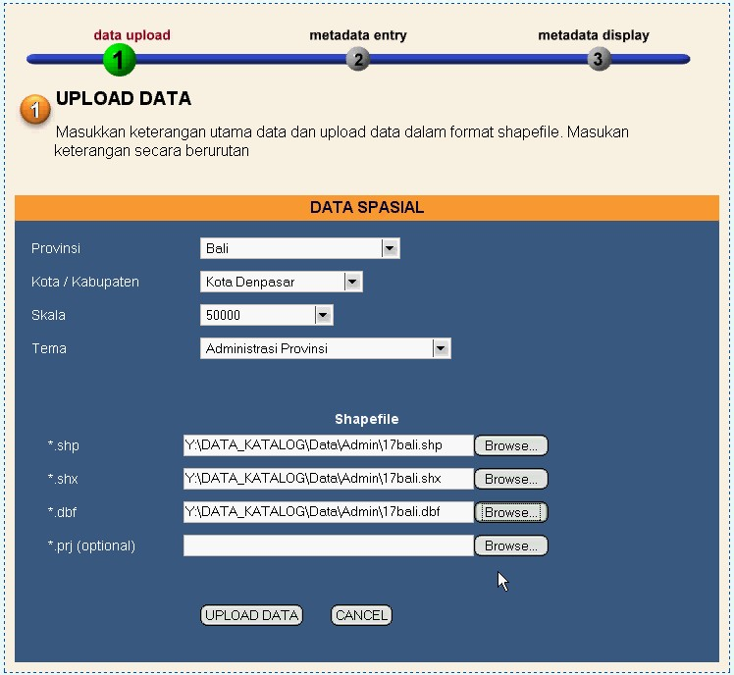
APPLICATION
Data upload

Slide 16
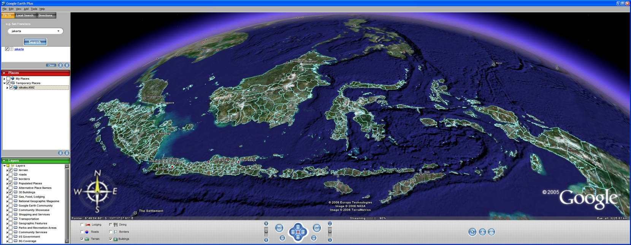
INTEROPERABILITY
Interoperability: the ability to share spatial data among data centers
WMS [Web Map Services] as a standard data exchange released by OGC [Open Geospatial Consortium] is applied
Data in WMS format can be opened by many GIS software

Slide 17
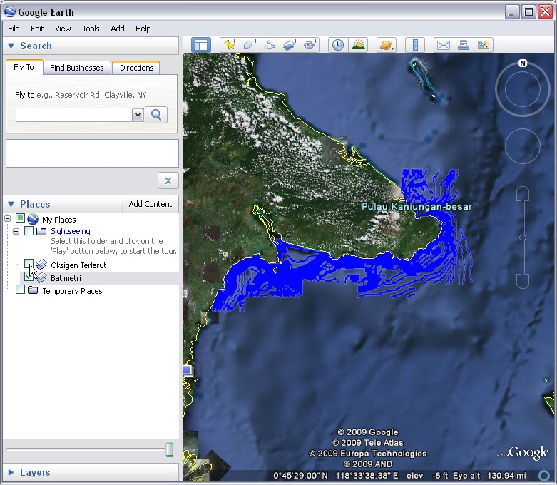
INTEROPERABILITY
WMS Data integratedin Google Earth

Slide 18


IMPLEMENTATION
The system has been installed at 15 provincial Bappeda, as well as training for staffs
Bappeda Riau is the only office which is able to share their data
Problems:
  Infratructure of the system not yet developed, including the internet system
  Limitation in human resources
??? ??

Slide 19
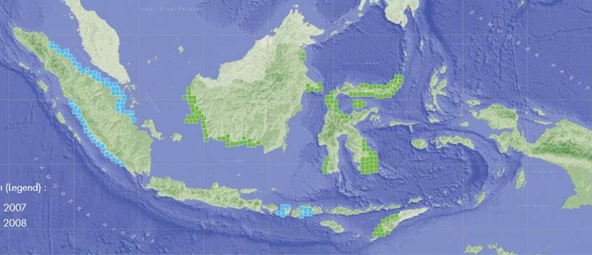
THE PROVINCIAL GOVERNMENT THAT HAS INSTALLED THE CATALOG SYSTEM
Riau Province: Sharing data
*Central celebes
*Bangka-Belitung island province

Slide 20
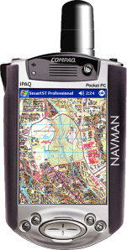
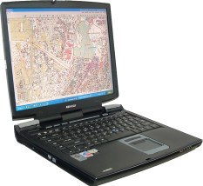
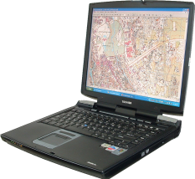
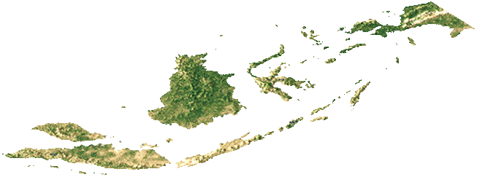
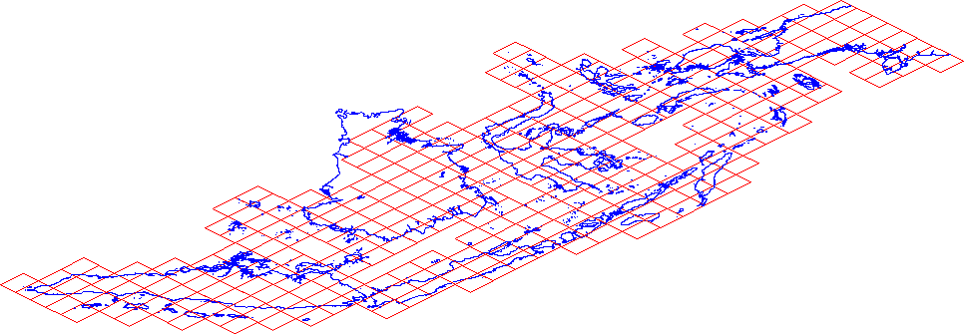
Conclusions
Spatial data can be publicly accessed
The system is based on international standard on data exchange
Other considered factors are:
  Server
  Internet connection
  Trained staffs
Geo-Spatial DBMS

Slide 21
Further Works
Add an English interface
System is incorporated as the Open Source mapping application
Community-based system → NGOs and privates can participate
Internet server available at regional offices
Regular data synchronization
Training regional staffs
Mobile catalog (this year program)
On line analytical process
FOSS4G | Sydney | October, 20 – 23 , 2009

Slide 22
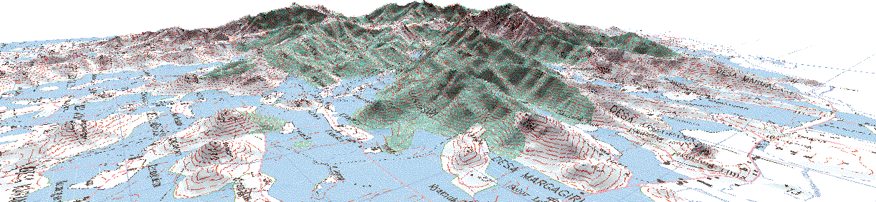
Please, look at:
http://pssdal.bakosurtanal.go.id
For More Information
FOSS4G | Sydney | October, 20 – 23 , 2009

Slide 23
THANK YOU
FOR YOUR ATTENTION

